Slide 1
Maximum Flow

Slide 2
Overview
Network flow
  Use a graph to model material that flows through conduits
  Each edge represents one conduit, and has a capacity ,which is an upper bound on the flow rate = units /time
  Can think of edges as pipes of different sizes. But flows don’t have to be of liquids. Book has an example where a flow is how many trucks per day can ship hockey pucks between cities.
  Want to compute max rate that we can ship material from a designated source to a designated sink

Slide 3






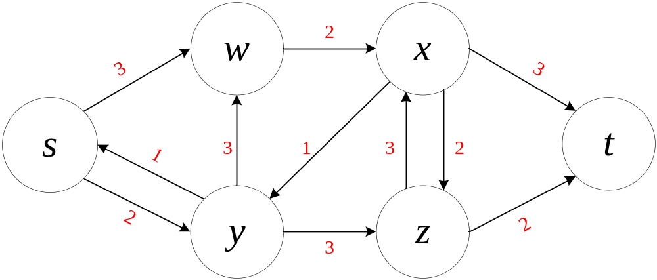
Flow networks
G = (V , E) directed.
Each edge (u , v) has a capacity c(u,v) 0
If (u , v) E ,then c (u , v) = 0.
Source vertex s, sink vertex t, assume for all
Example: [Edge are labeled with capacities.]

Slide 4

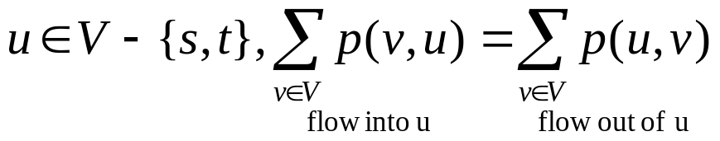
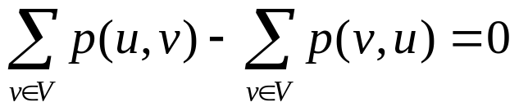
Positive flow :A function p : V × V → R satisfying
  Capacity constraint: For all
  Flow conservation: For all
  Equivalently,

Slide 5
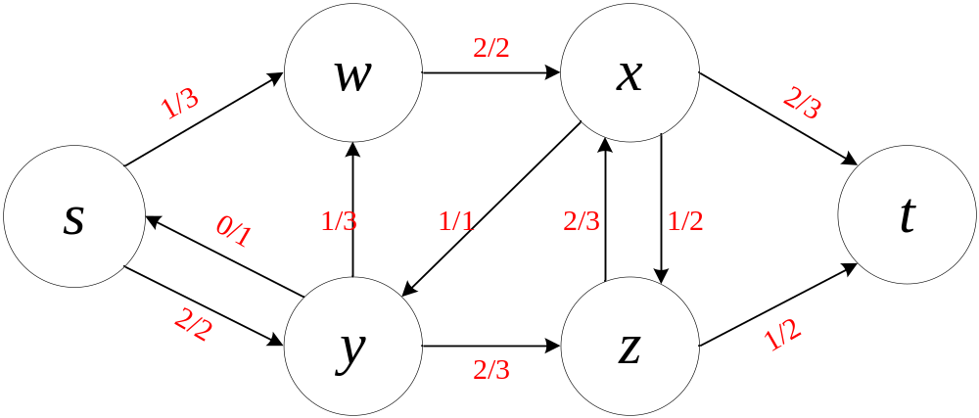

Note that all positive flow are capacities.
Verify flow conservation by adding up flow at a couple of vertices
Note that all positive flow = 0 is legitimate

Slide 6
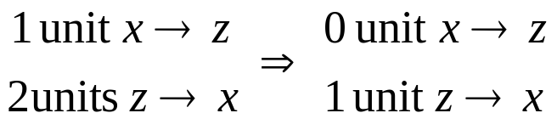
Cancellation with positive flows
Without loss of generality, can say positive flow goes either from u to v or from v to u ,but not both.( Because if not true, can transform by cancellation to be true.)
In the above example, we can “cancel” 1 unit of flow in each direction between x and z
In both case, ”net flow” is 1 unit z → x
Capacity constraint is still satisfied (because flow only decrease)
Flow conservation is still satisfied (flow in and flow out are both reduced by the same amount)

Slide 7

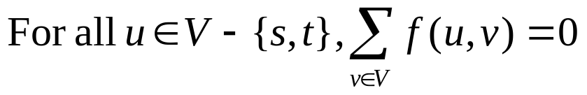
Here’s a concept similar to positive flow:
Netflow: A function f : V × V → R satisfying
Capacity constraint:
Skew symmetry:
Flow conservation:

Slide 8
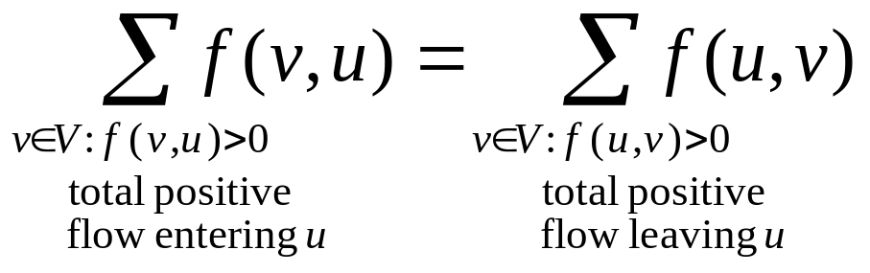

Another way to think of flow conservation:
“flow in =flow out”
The differences between positive flow p and net flow f
  f satisfies skew symmetry

Slide 9
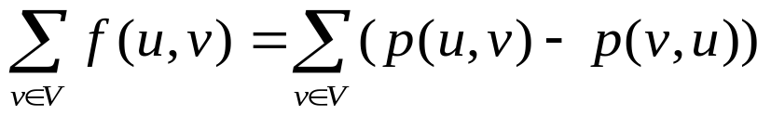
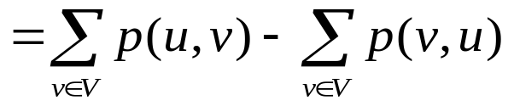

Equivalence of positive flow and net flow definitions
Define net flow in terms of positive flow:
Define f( u , v) = p( u ,v) - p( v ,u)
Argue, given definition of p ,that this definition of f satisfies capacity constraint and flow conservation
Capacity constraint:
Flow conservation:

Slide 10

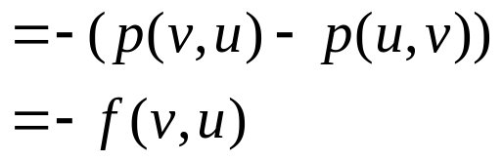
Skew symmetry is trivially satisfied by the definition of

Slide 11
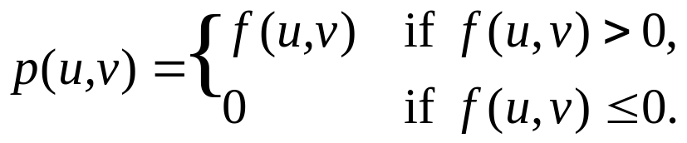
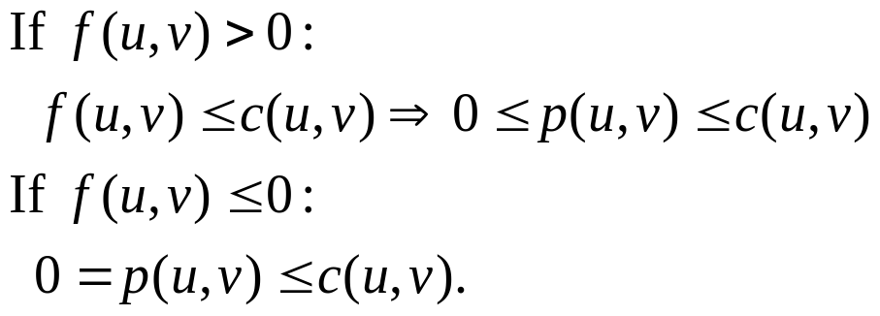
Define positive flow in terms of net flow:
Argue, given definition of f , that this definition of p satisfies capacity constraint and flow conservation.
Capacity constraint:

Slide 12
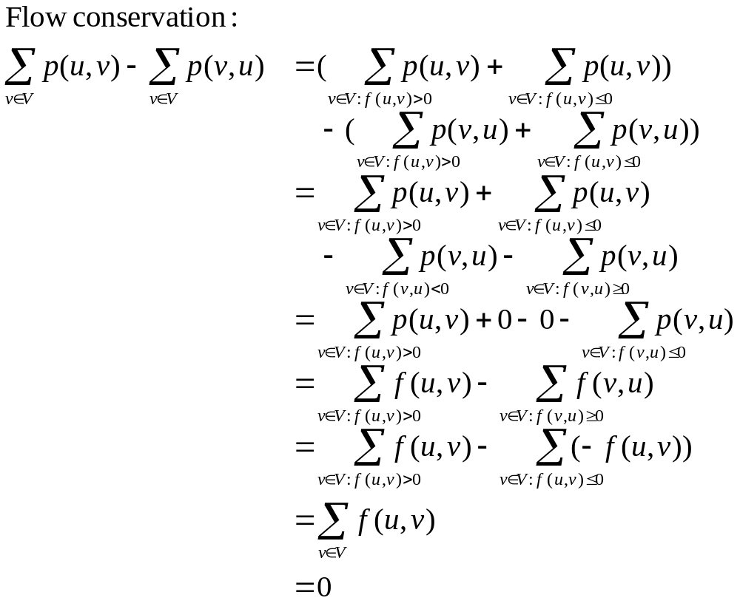

Slide 13
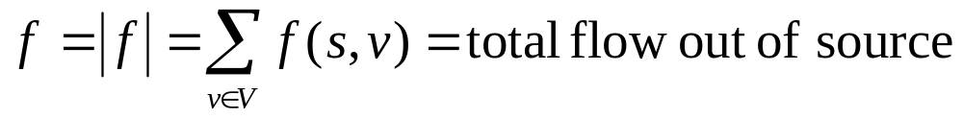
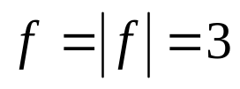
Value of flow
Consider the example blow. [The cancellation possible in the previous
example has been made here. Also, showing only flows that are positive.]
Value of flow

Slide 14
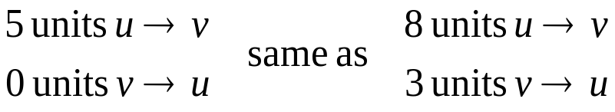
Cancellation with flow
If we have edges (u , v) and (v , u) ,skew symmetry makes it so that at most \
one of these edges has positive flow.
Say f (u ,v) = 5 .If we “ship” 2 units v → u. we lower f (u ,v) to 3.The 2 units
v → u cancel 2 of the u → v units.
Due to cancellation, a flow only gives us this “net” effect. We cannot
reconstruct actual shipments from a flow
We could add another 3 units of flow u → v and another 3 units
v → u ,maintaining flow conservation.
The flow from u to v would remain f (u ,v) = 5 ,and f (v ,u) = -5.

Slide 15
Maximum-flow problem: Given G,s,t and c, find a flow whose value is
maximum.
Implicit summation notation
We work with function, like f ,that take pairs of vertices as arguments. Extend
to take sets of vertices, with interpretation of summing over all vertices in the
set.

Slide 16
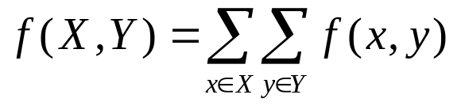

Example: If X and Y are sets of vertices,
Therefore, can express flow conservation as
Notation: Omit braces in sets with implicit summations.
Example:

Slide 17
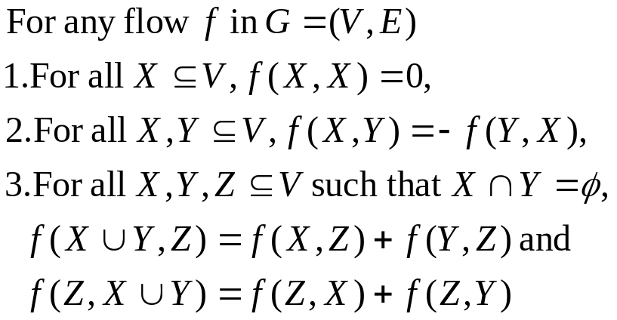
Lemma

Slide 18
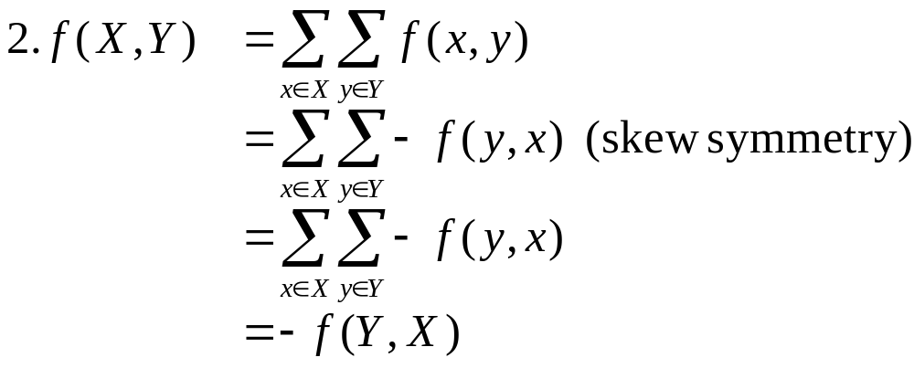
Proof

Slide 19
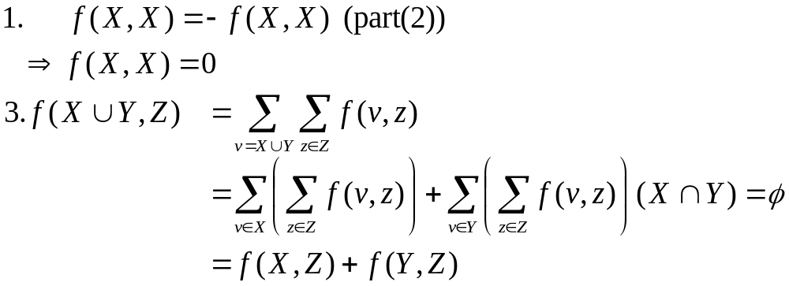
Proof

Slide 20


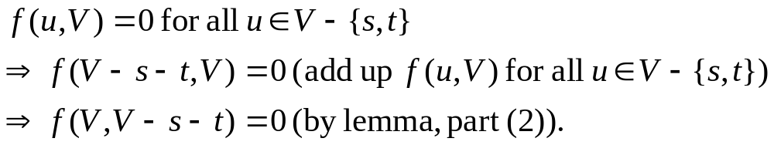
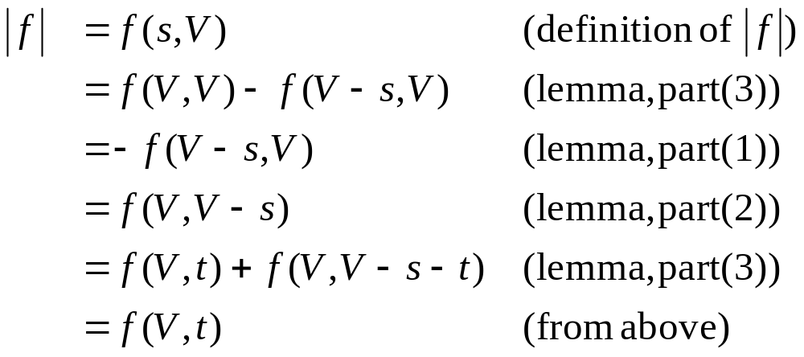
Lemma
Proof First, show that
Thus,

Slide 21

Cuts
A cut (S,T) of flow network G = (V,E) is a partition of V into S and T=V-S
such that
Similar to cut used in minimum spanning trees, except that here the graph is directed, and we require
For flow f, the net flow across cut (S , T) is f (S , T).
Capacity of cut (S , T) is c (S , T).
A minimum cut of G is a cut whose capacity is minimum over all cuts of G.

Slide 22
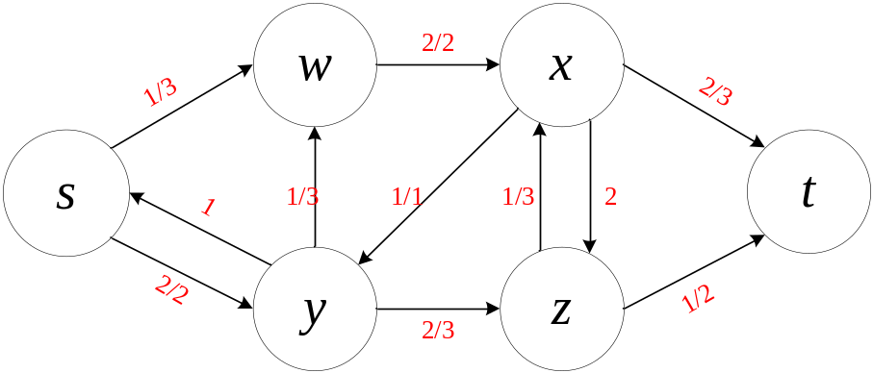

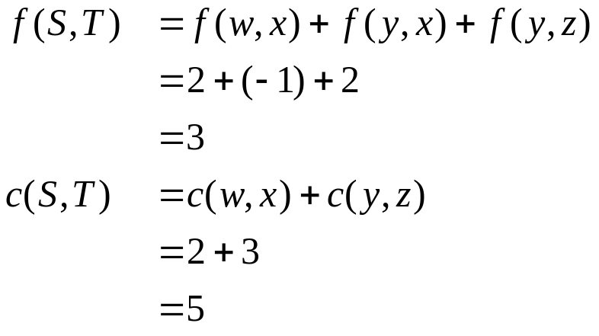
For our example:
Consider the cut
Same flow as previous cut, higher capacity.

Slide 23
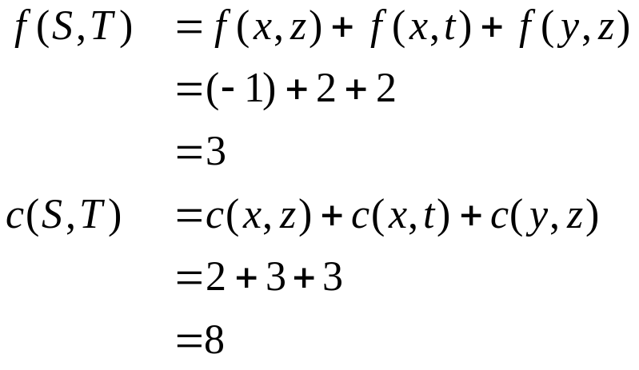
Note the difference between capacity and flow.
Flow obeys skew symmetry, so f (y , x) = -f (x , y) = -1.
Capacity does not: c (y , x) = 0 ,but c (x , y) = 1.
So include flows going both ways across the cut, but capacity going only S to
T.
Now consider the cut

Slide 24



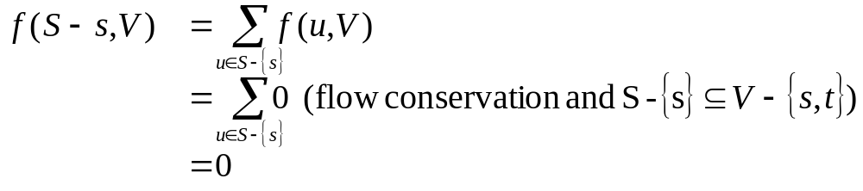
Lemma
For any cut (S,T),
Proof First, show that
Therefore,

Slide 25
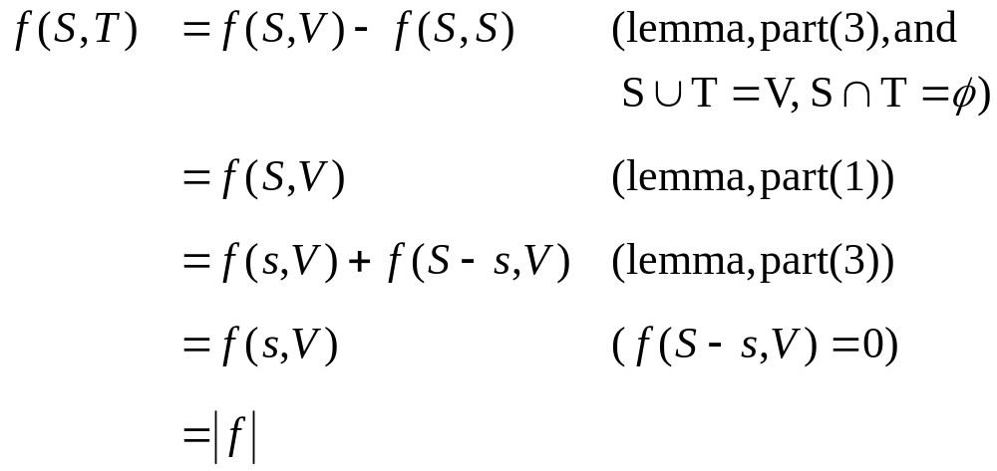
So

Slide 26

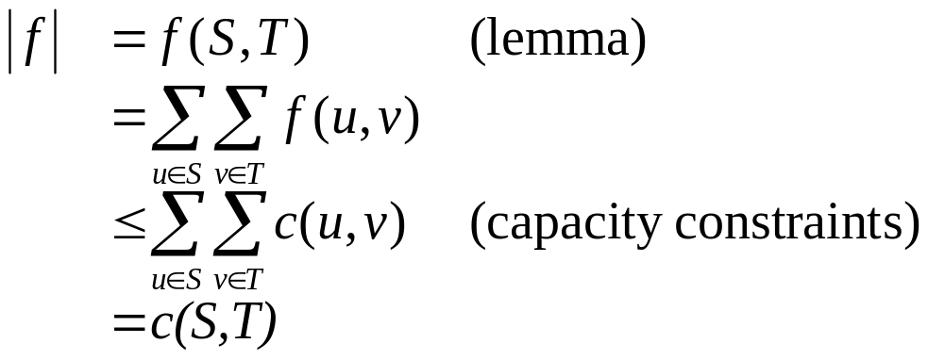
Corollary
The value of any flow capacity of any cut.
Proof Let (S,T) be any cut, f be any flow.
Therefore, maximum flow capacity of minimum cut. Will see a little later
that this is in fact an equality.

Slide 27

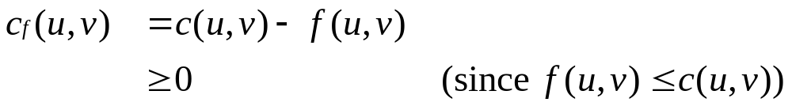
The Ford-Fulkerson Method
Residual network
Given a flow f in network G = (V , E)
Consider a pair of vertices u , v V.
How much additional flow can we push directly from u to v ?
That’s the residual capacity.

Slide 28


Residual network:
Each edge of the residual network can admit a positive flow.

Slide 29
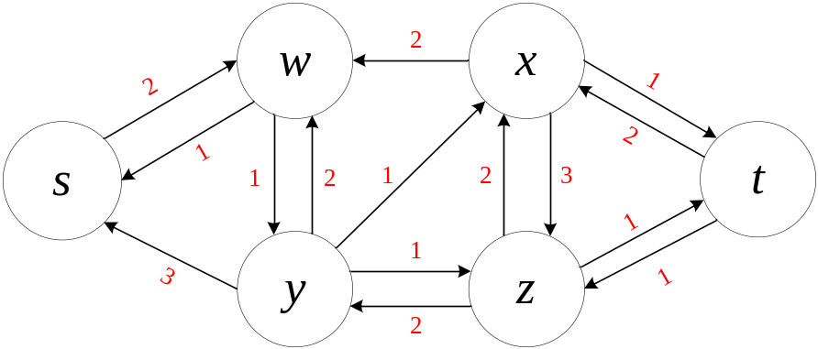

For our example:
Every edge (u , v) E_{f} corresponds to an edge (u , v) E or (u , v) E (or both)
Therefore,
Given flows f₁ + f₂ ,the flow sum f₁ + f₂ is defined by
( f₁ + f₂ ) (u , v) = f₁ (u , v) + f₂ (u , v)
For all u , v V

Slide 30

Lemma
Given a flow network G, a flow f in G, and the residual network G_{f} ,let f’ be
any flow in G_{f} .Then the flow sum f + f’ is a flow in G with value
[See book for proof]

Slide 31

Augmenting path
A path s t in G_{f} .
Admits more flow along each edge
Like a sequence of pipes through which we can squirt more flow from s to t
How much more flow can we push from s to t along augmenting path p?

Slide 32

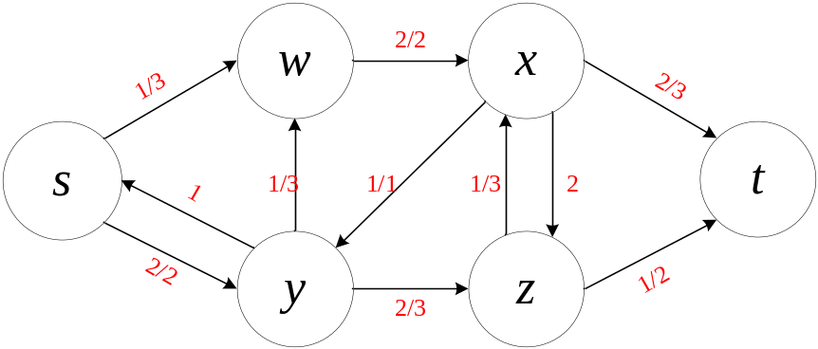
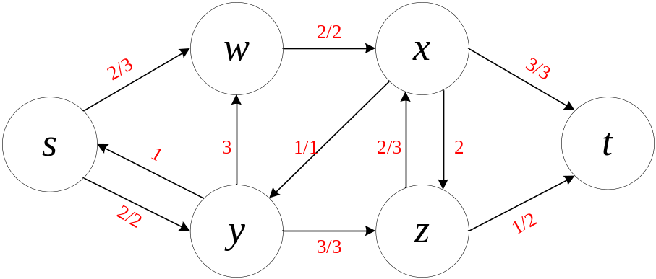
For our example, consider the augmenting path
Minimum residual capacity is 1.
After we push 1 additional unit along p:

Slide 33
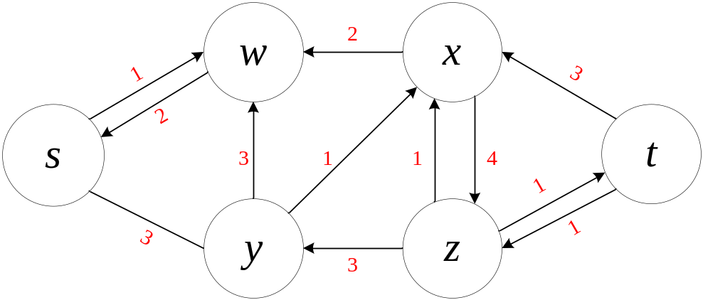
Observe that G_{f} now has no augmenting path. Why? No edges cross the cut
({ s , w },{ x , y , z , t }) in the forward direction in G_{f} .So no path can get from
s to t. Claim that the flow shown in G is a maximum flow.

Slide 34
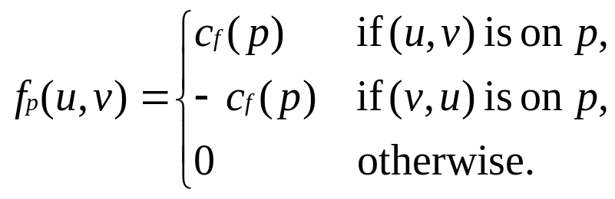
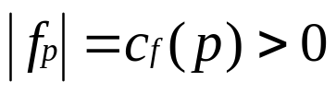
Lemma
Given flow network G, flow f in G, residual network G_{f}. Let p be an
augmenting path in G_{f} . Define f_{p} : V × V → R:
Then f_{p} is a flow in G_{f} with value

Slide 35

Corollary
Given flow network G, flow f in G, and a augmenting path p in G_{f} ,define f_{p} as
in lemma, and defin f’ : V × V → R by f’ = f + f_{p.} Then f’ is a flow in G with
Value

Slide 36

Theorem (Max-flow min-cut theorem)
The following are equivalent:
f is a maximum flow.
f admits no augmenting path
|f| = c (S , T) for some cut (S , T)
Proof
If f admits an augmenting path p ,then (by above corollary) would get a flow
with value |f| + c_{f}(p) > |f| , so f wasn’t a max flow to start with.

Slide 37

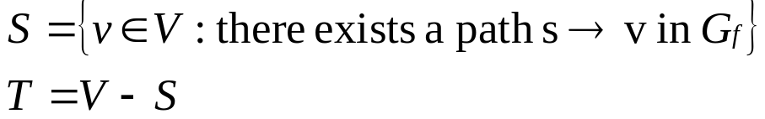



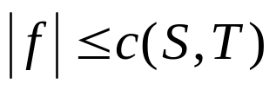

Suppose f admits no augmenting path. Define
Must have ;otherwise there is an augmenting path.
Therefore, ( S , T ) is a cut.
For each , must have f ( u , v) = c (u , v) , since otherwise
(u , v) Ef and the v S
By lemma (f ( S , T ) = |f| ), |f| = f ( S , T ) = c ( S , T ).
By corollary,

Slide 38
Ford-Fulkerson algorithm
FORD-FULKERSON (V , E , s , t)
for all (u , v) E
do f [u , v] ← f [v , u] ← 0
while there is an augmenting path p in G_{f}
do augment f by c_{f} (p)
Subtle different between f [u , v] and f (u , v):
f (u , v) is a function, defined on all u ,v V
f [u , v] is a value computed by algorithm.
  f [u , v] = f (u , v) where (u , v) E or (v , u) E
  f [u , v] is undefined if neither (u , v) E nor (v , u) E

Slide 39

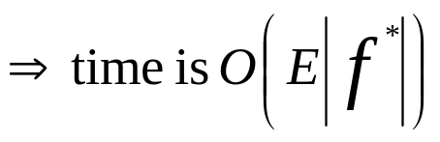

Analysis: If capacities are all integer, then each augmenting path raises
If max flow is f* , then need |f*| iterations
Now that this running time is not polynomial in input size. It depends on
|f*| ,which is not a function of |V| and |E|.
If capacities are rational, can scale them to integers.
If irrational, FORD-FULKERSON might never terminate.

Slide 40
Edmonds-Karp algorithm
Do FORD-FULKERSON, but compute paths by BFS of G_{f} , Augmenting
paths are shortest path s t in G_{f} . With all edge weights = 1.
Edmonds-Karp runs in O(V E²) time.
To prove, need to look at distance to vertices in G_{f.}
Let δ_{f} (u , v) = shortest path distance u to v in G_{f} , with unit edge weights.

Slide 41

Lemma
For all increases monotonically with each flow
augmentation.

Slide 42


Proof
Suppose there exists such that there is a flow augmentation that
cause δ_{f} (s , v) to decrease. Will derive a contradiction.
Let f be the flow before the first augmentation that causes a shortest-path
distance to decrease, f’ be the flow afterward.
Let v be a vertex with minimum δ_{f’} (s , v) whose distance was decreased by
the augmentation, so δ_{f’} (s , v) < δ_{f} (s , v) .
Let a shortest path s to v in G_{f’} be s u → v, so (u , v) E_{f ’} and
δ_{f ‘}(s , v) =δ_{f ’} (s , u) + 1. (Or δ_{f’} (s , u) = δ_{f’} (s , v) - 1 .)
Since δ_{f ‘} (s , u) < δ_{f ‘} (s , v) and how we chose v, we have
δ_{f ‘} (s , u) δ_{f} (s , v) .

Slide 43


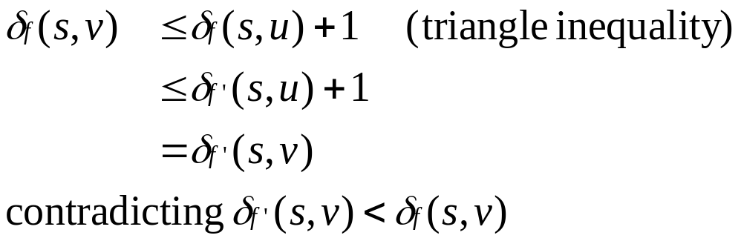


Claim
Proof If ,then
How can and ?
The augmentation must increase flow v to u. Since Edmonds-Karp augments
along shortest paths, the shortest path s to u in G_{f} has v → u as its last edge.

Slide 44
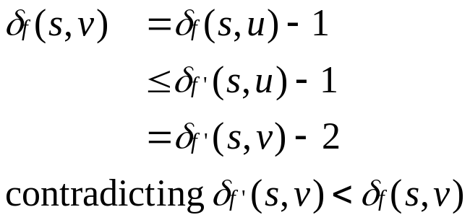
Therefore,
Therefore, v cannot exist.

Slide 45

Theorem
Edmond-Karp performs O(V E) augmentations.
Proof Suppose p is an augmenting path and c_{f} (u , v) = c_{f} (p). Then call (u , v) a
critical edge in G_{f} , And it disappears from the residual network after an
augmentation along p .
edge on any augmenting path is critical.
Will show that each of the |E| edges can become critical |V|/2 – 1 times.
Consider u,v V such that either (u , v) E or (v , u) E or both. Since
augmenting paths are shortest paths, when (u , v) becomes critical first time,
δ_{f} (s , v) = δ_{f} (s , u) + 1

Slide 46

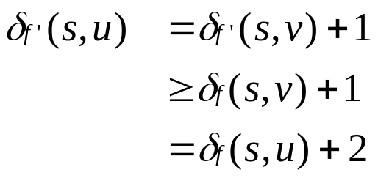
Augment flow, so that (u , v) disappears from the residual network. The edge
cannot reappear in the residual network until flow from u to v decreases,
which happens only if (v , u) is on an augmenting path in
G_{f ‘} :δ_{f ‘} (s , u) = δ_{f ‘} (s , v) +1 ( f ‘ is flow when this occurs)
By Lemma,

Slide 47






Therefore, from the time (u , v) becomes critical to the next time, distance of
u from s increases by .Initially, distance to u is , and augmenting path
can’t have s, u, and t as intermediate vertices.
Therefore, until u becomes unreachable from source, its distance is
can become critical
Since O(E ) pairs of vertices can have an edge between then in residual graph,
total # of critical edges is O(V E). Since each augmenting path has critical
edge, have O(V E) augmentations.
Use BFS to find each augmenting path in O(E ) time O(V E²) time.
Can get better bounds.
Push-relabel algorithms in Sections 26.4-26.5 give O(V³).
Can do even better.

Slide 48
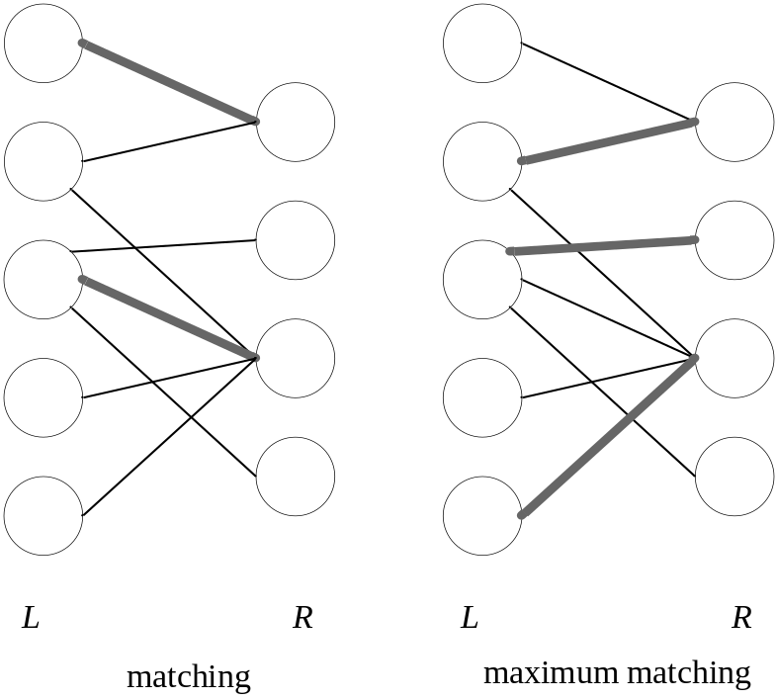
Maximum bipartite matching
Example of a problem that can be solved by turning it into a flow problem.
G = (V , E) (undirected) is bipartite if we can partition V = L ∪ R such that all
edges in E go between L and R.

Slide 49


A matching is a subset of edges M E such that for all v V , edge of M
is incident on v .(Vertex v is matched of an edge M is incident on it, otherwise
unmatched).
Maximum matching: a matching of maximum cardinality. (M is a maximum
matching if |M| |M’| for all the matchings M’.)

Slide 50
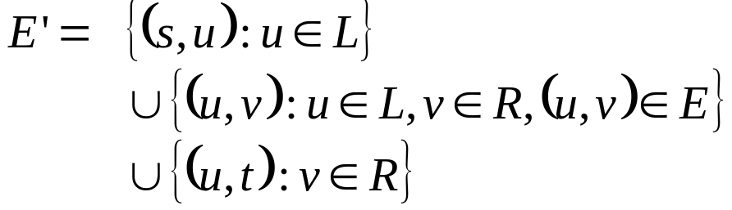

Problem:
Given a bipartite graph (with the partition), find a maximum matching.
Application:
Matching planes to routes.
L = set of planes.
R = set pf routes.
(u , v) E if plane u can fly route v .
Want maximum # of routes to be served by planes.
Given G, define flow network G’ = (V’ , E’)
V’ = V ∪ {s , t}

